Slide 1
NDA Review Workshop Vemurafenib (Zelboraf, Roche) for metastatic melanoma
IND: 2006-09-01| NDA Submission: 2011-04-28 | FDA Approval: 2011-08-17
Sungpil Han, M.D./Ph.D.
Dept. of Clinical Pharmacology & Therapeutics
Asan Medical Center
2018-09-27
Notes:
https://www.accessdata.fda.gov/drugsatfda_docs/nda/2011/202429s000TOC.cfm

Slide 2
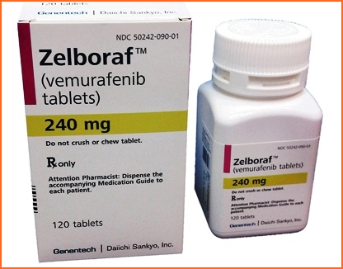
Vemurafenib (Zelboraf®) Product Profile
U.S. Sponsor: Roche Inc.
Indication:
Unresectable or metastatic melanoma with the BRAF V600 mutation as detected by an FDA approved test.
Tablet: 240 mg
960 mg orally, BID
NDA 202429

Slide 3
Table of Contents
Introduction
Target identification
CMC Review
Pharmacology Review
Medical Review, Clinical Pharmacology Review
Companion Diagnostics
Discussion

Slide 4
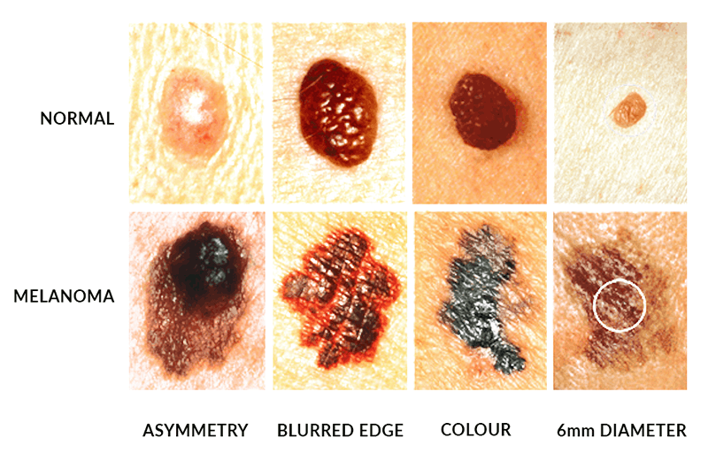
Introduction - Melanoma
Melanoma
5th leading cancer type in men
7th leading cancer type in women
estimated total of 76,100 new cases
9,700 deaths due to melanoma in 2014
Prognosis of metastatic melanoma
Median survival of approximately 6 months
(Jemal 2010, CA Cancer J Clin 60(5): 277-300; Howlander 2011, SEER Cancer Statistics Review)

Slide 5
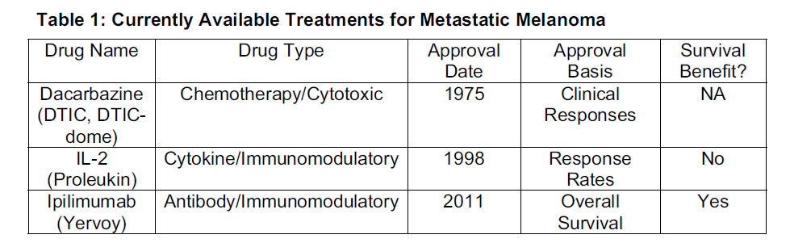
Introduction
3 drugs were approved by the FDA for the treatment of advanced melanoma.
Dacarbazine was approved over 30 years ago
no survival benefit has been demonstrated.
response rates with single-agent dacarbazine: 7% to 32%
OS: 5.6 to 11 months
Aldesleukin (IL-2) approval in 1998
A meta-analysis of chemoimmunotherapy versus chemotherapy found increased response rates and toxicity with chemoimmunotherapy
no improvement in survival

Slide 6
Introduction
Ipilimumab
monoclonal antibody targeting CTLA-4
approved in 2011
Median OS
ipilimumab–dacarbazine group : 11.2 months
dacarbazine group : 9.1 months
HR, 0.72 (95% CI, 0.59–0.87)

Slide 7
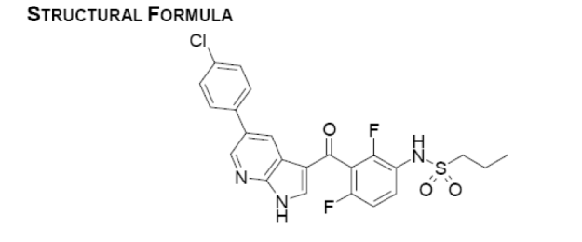





Introduction
PLX4032 or Vemurafenib (V600E mutant Raf inhibitor)
Plexxikon (Berkeley, California, US)
Structural biology-based platform called Scaffold-Based Drug Discovery (Vemurafenib)
Founded by Joseph Schlessinger (Yale) and Sung-Hou Kim (UC Berkeley) (2001)
Later acquired by the Japanese pharmaceutical company Daiichi Sankyo (2011)
2006
2011

Slide 8
2. Target Identification & Discovery

Slide 9
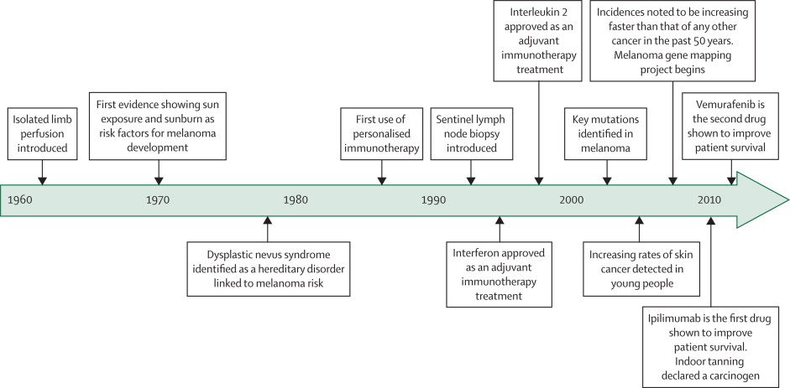
Timeline highlighting key events of the treatment of melanoma
(Bombeli, Lancet, 2014)
Notes:
Timeline highlighting key events since the 1960s that have directly affected the prevention and treatment of melanoma
Based on information made available from the American Society of Clinical Oncology.

Slide 10

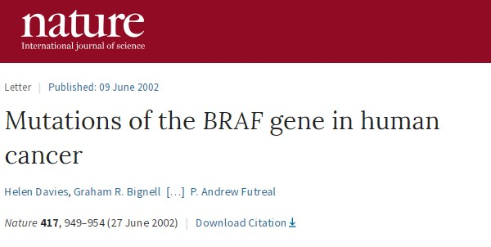
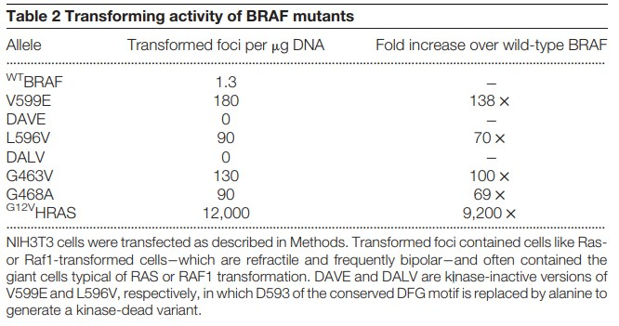
Landmark Paper

Slide 11
Introduction
Most mutations occur at a single codon, codon 600 (Davies, Nature, 2002)
replacing valine most typically with glutamic acid (the V600E mutation).
Activation loop of BRAF
Mutations: substantially increase kinase activity to drive the proliferation of cancer cells
Highest frequency of BRAF mutation: malignant melanoma (~60%)
Malanocyte biology: melanocortin receptor I, cAMP-dependent signalling cascade activates BRAF and subsequently ERK.
Somatic mutations in BRAF
V600E mutation among BRAF-mutated melanomas
Frequency: 80–90% (COSMIC; Lovly et al. 2012; Rubinstein et al. 2010)

Slide 12
Kinase inhibitor
Subject of intensive drug discovery
High-throughput screening (Early 2000)
Inhibition of kinase activity
quinazolines, amino-pyrimidines, oxindoles
Not able to inhibit BRAF
Scaffold-Based Drug Discovery
integrates multiple state-of-the-art technologies,
structural screening as one key component
MW 150-350Da
fewer than eight hydrogen bond donors and acceptors, few rotatable bonds and relatively high aqueous solubility
initial screen, 238 compounds were selected for co-crystal analysis: the compounds were mixed with crystallography-grade, recombinant kinase domains from the various kinases that the compounds bound in buffers favouring crystal growth.

Slide 13
Kinase 는 1980년대부터 신약개발의 타겟으로 가장 많이 연구되어 졌고, 현재도 연구되고 있는 타겟이다. 2000년대 초반에 High-Throughput Screening (HTS)을 이용하여 많은 수의 화합물 library를 스크리닝 하였고, kinase activity를 저해하는 여러 개의 compound class를 발견하였다. 예를 들면 quinazolines, amino-pyrimidines, oxindoles 등이 있다.
하지만 이중에서 BRAF를 저해하는 물질은 없었다.
그림4. 대표적 kinase 저해 scaffold
Plexxikon 회사에서 BRAF inhibitor를 찾기 위하여 scaffold-based approach를 사용하였다. 다음과 같은
chemical properties ()를 가진 scaffold 화합물을 검색을 하였다.

Slide 14
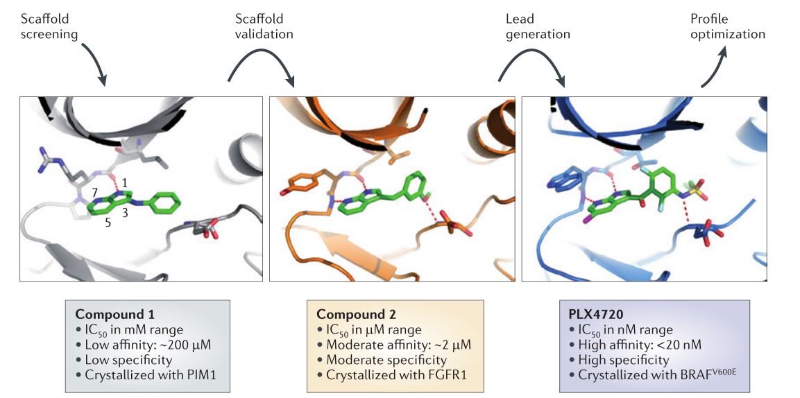
From scaffold to lead compound.
Notes:
Hits that were identified from screening a library of ‘scaffold-like’
compounds were co-crystallized with representative kinases. The figure shows the co-structure of the azaindole
scaffold (compound 1) with the serine/threonine kinase PIM1. The scaffold was validated by synthesizing a set of
3-substituted compounds guided by the co-structure, which resulted in a more potent azaindole analogue (compound
2); this compound, when co‑crystallized with the kinase domain of the fibroblast growth factor receptor 1 (FGFR1),
revealed a key hydrogen bond interaction with the DFG (Asp-Phe-Gly) backbone. Further structure-guided
optimization resulted in PLX4720, the analogue of vemurafenib, which is shown here in complex with the BRAF V600E
protein 62 . IC 50 , half-maximal inhibitory concentration. Images modified, with permission, from REF. 62

Slide 15
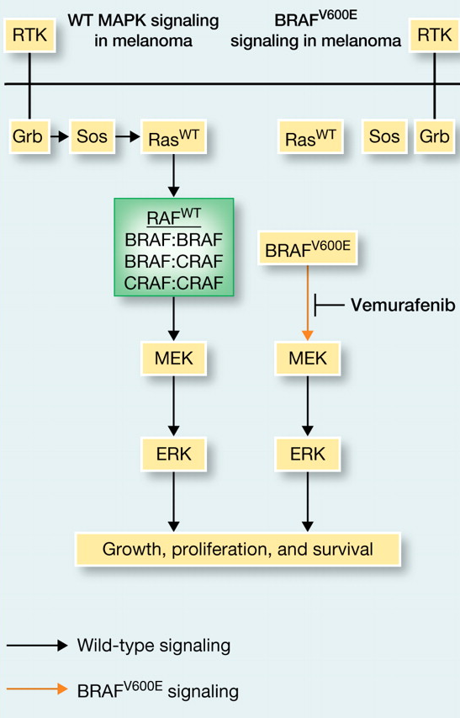
Introduction
Vemurafenib
Synthesized in 2005
BRAF_{V600E}: Selective binding to active form
Vemurafenib vs MEK inhibitor
Both: inhibition of cell proliferation
MEK inhibitor: inhibition of ERK phosphorylation in all cellular genotypes
Vemurafenib: ERK-phosphorylation only in BRAF-mutant cells
RAF inhibitor paradox
Paradoxical ERK phosphorylation induced by vemurafenib in WT BRAF cell

Slide 16
3. Review: CMC (39 pages)
Chemistry, manufacturing, control

Slide 17
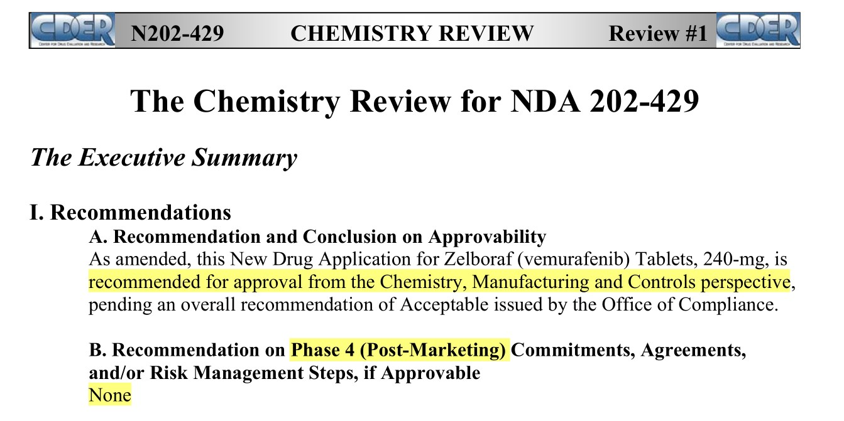
CMC

Slide 18
CMC
Drug Substance
BCS Class IV (Poor aqueous solubility and low bioavailability)
Standard protection from moisture and light
Drug Product
Film-coated tablets containing 240 mg of vemurafenib for oral administration
Oval, biconvex, pinkish white, engraved with VEM
Reformulation: microprecipitated bulk powder (MBP)
Expiry of 12 months at 25°C storage condition
Proposed dose of vemurafenib in adult patients is 960 mg (four 240 mg tablets) twice daily
Supplied in bottles of 120.

Slide 19
Medical Review, Clinical Pharmacology Review

Slide 20
Development Overview
Works well in vitro and in lab animals
Clinical trails begun 2008
Enrolled only patients with BRAF_{V600E}
Phase I: 16 patients with stage IV cancers
Median survival increased 9 → 15 months
Phase II: 132 patients with stage IV cancers
53% of patients responded. Similar increase in survival
Phase III: 675 patients with stage III or IV cancers
compared vemurafenib to dacarbazine
Stopped early. Dacarbazine patients moved to vemurafenib
FDA approval August 2011

Slide 21
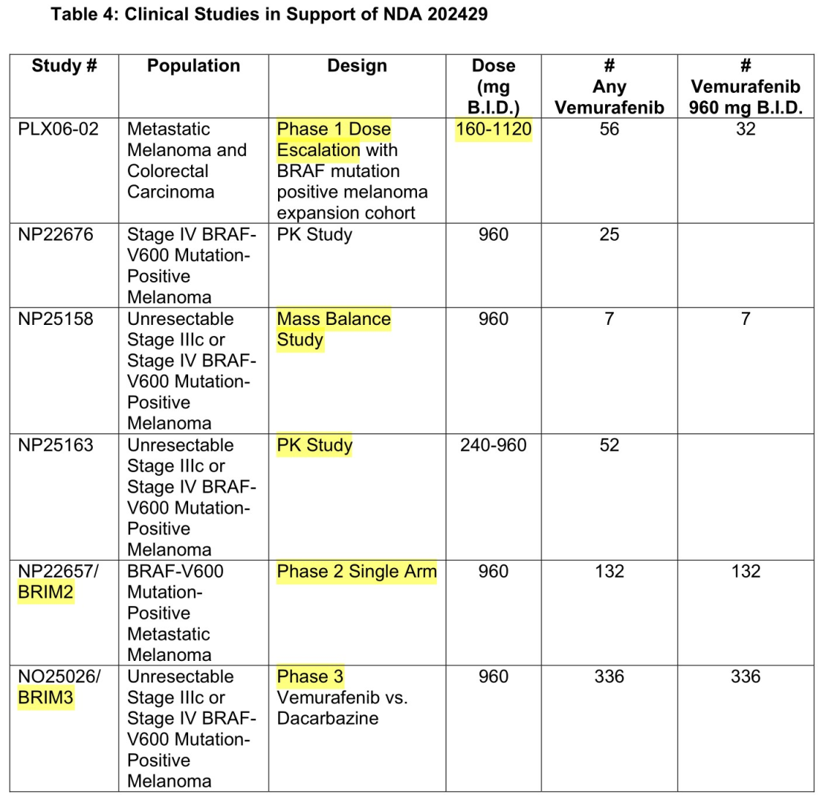
Crystalline Powder
Reformulation

Slide 22
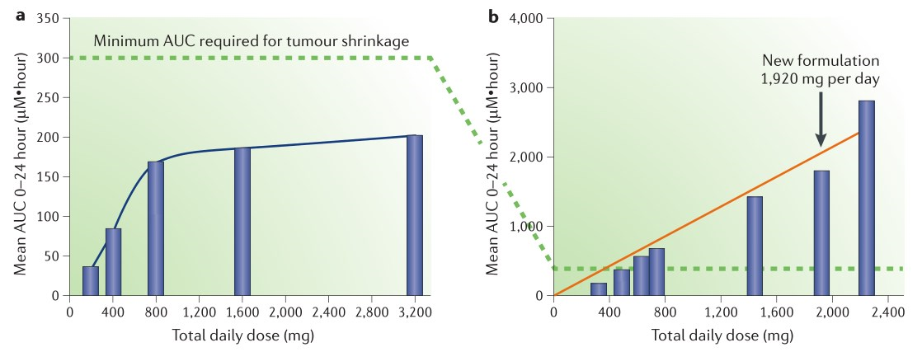
Reformulation: Increased exposure
initial crystalline formulation
Reformulation of vemurafenib (a microprecipitated bulk powder)
Notes:
Pharmacokinetic analysis of vemurafenib exposure in human plasma. a | The initial crystalline formulation
led to saturation of exposure despite very high daily doses. This highlighted the need for a new formulation. The exposure
of 300 μM multiplied by hour (300 μM•hour) calculated from preclinical studies (see FIG. 3 ), which was required to
cause tumour regression, is indicated by the dotted line. b | Reformulation of vemurafenib as a microprecipitated bulk
powder led to a sixfold improvement in plasma levels of the drug without causing apparent saturation 78,92 . AUC, area
under the curve.

Slide 23
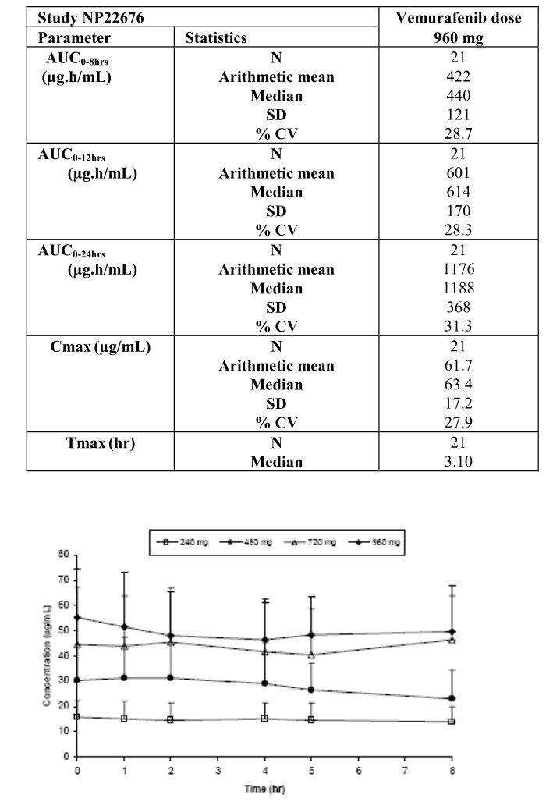
Clinical Pharmacology
Population PK
plasma concentration-time profile
one-compartment pharmacokinetic model
first-order absorption and first-order elimination.
PK at steady state
linear between 240 and 960 mg
Oral administration of 960 mg twice daily (for 15 days)
t_{max:} : ~ 3 hours
C_{max} :62 μg/mL ± 17
AUC0–12 : 601 ± 170 μg*h/mL.
FES: not been conducted
vemurafenib was administered without regard to food in the clinical trial.

Slide 24
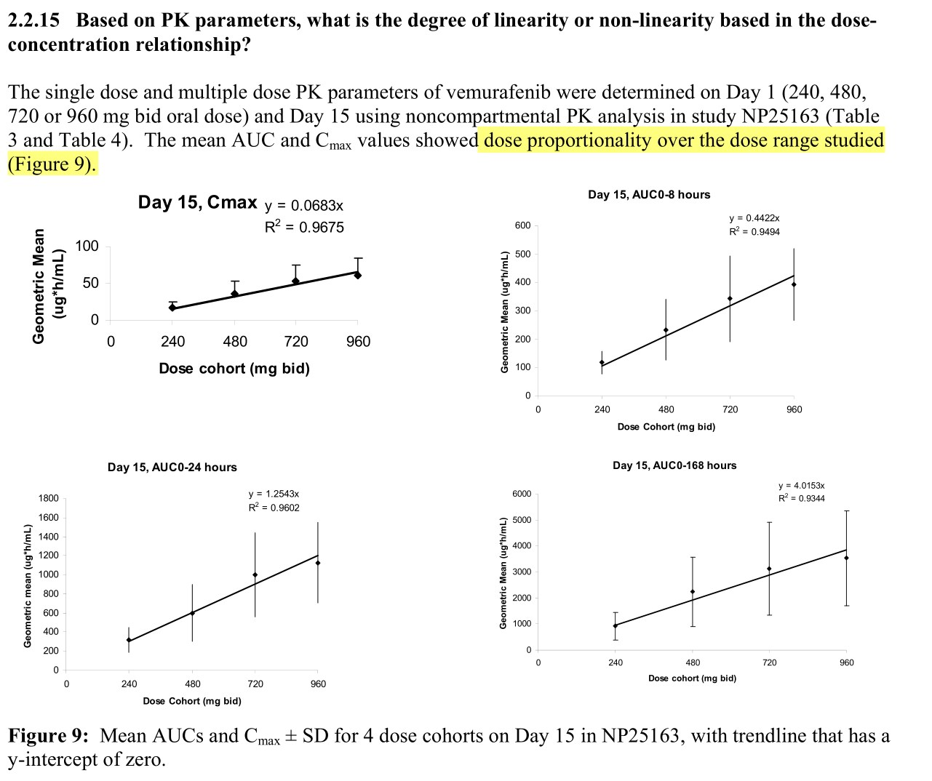

Slide 25
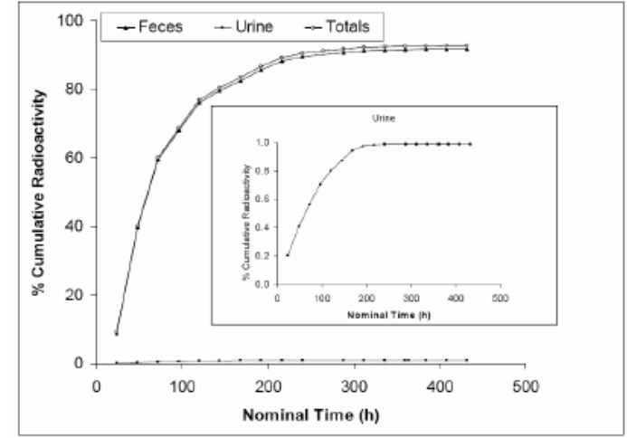
Clinical Pharmacology
Protein binding
highly bound (>99%) to human albumin and alpha-1 acid glycoprotein, and
Volume of distribution (V_{ss}): 106 L.
Elimination
Excretion
mainly excreted in feces (94%)
Plasma clearance
31 L/day
Median elimination half-life
57 hours
¹⁴ C-vemurafenib

Slide 26
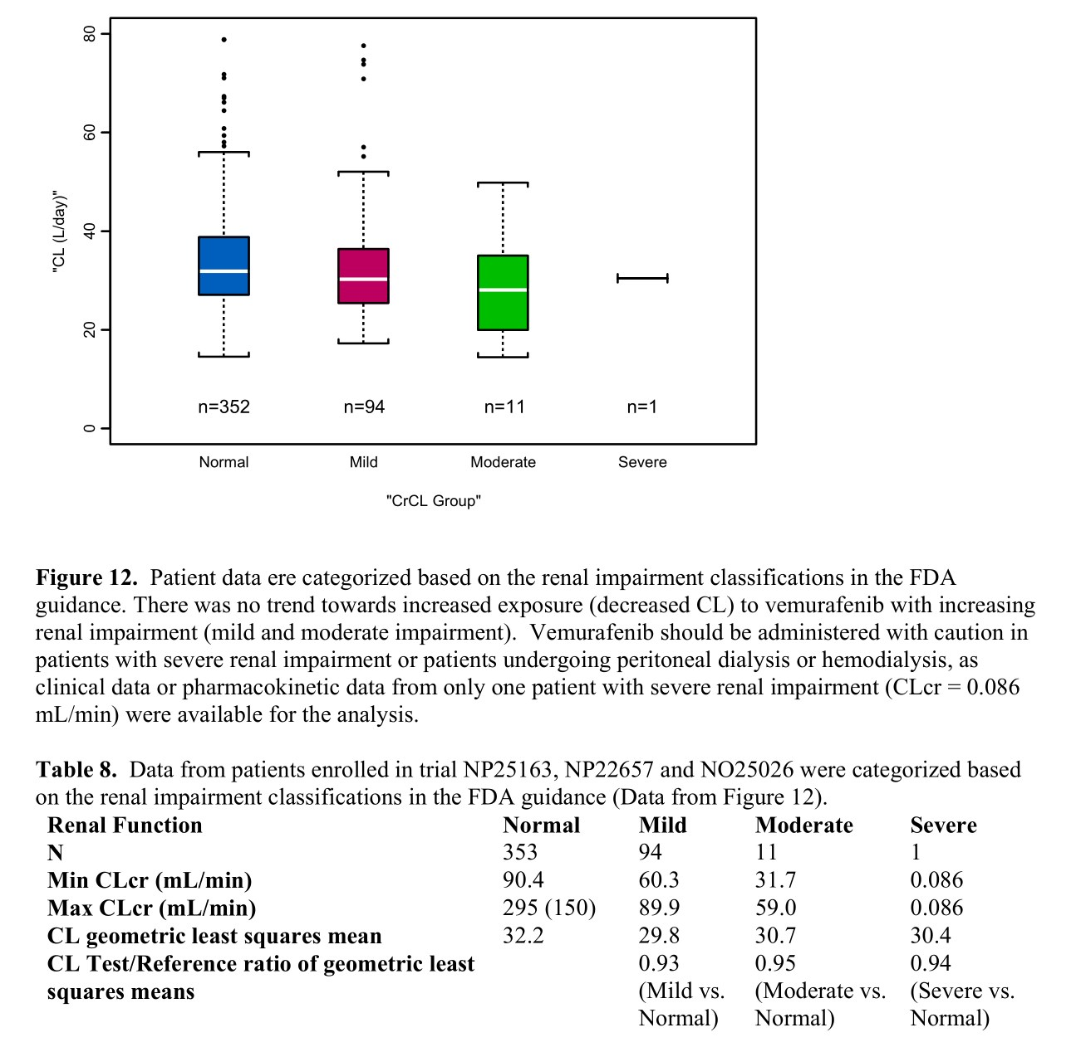

Slide 27
Clinical Pharmacology
Hepatic impairment
Vemurafenib clearance was similar in patients with normal, mild, and moderate hepatic impairment
“Therefore, dose adjustments are not needed for mild and moderate hepatic impairment.”
effect of severe hepatic impairment on vemurafenib exposure was unknown.
Drug Interaction
In vitro
substrate of CYP3A4 and
both a substrate and inhibitor of P-glycoprotein.

Slide 28
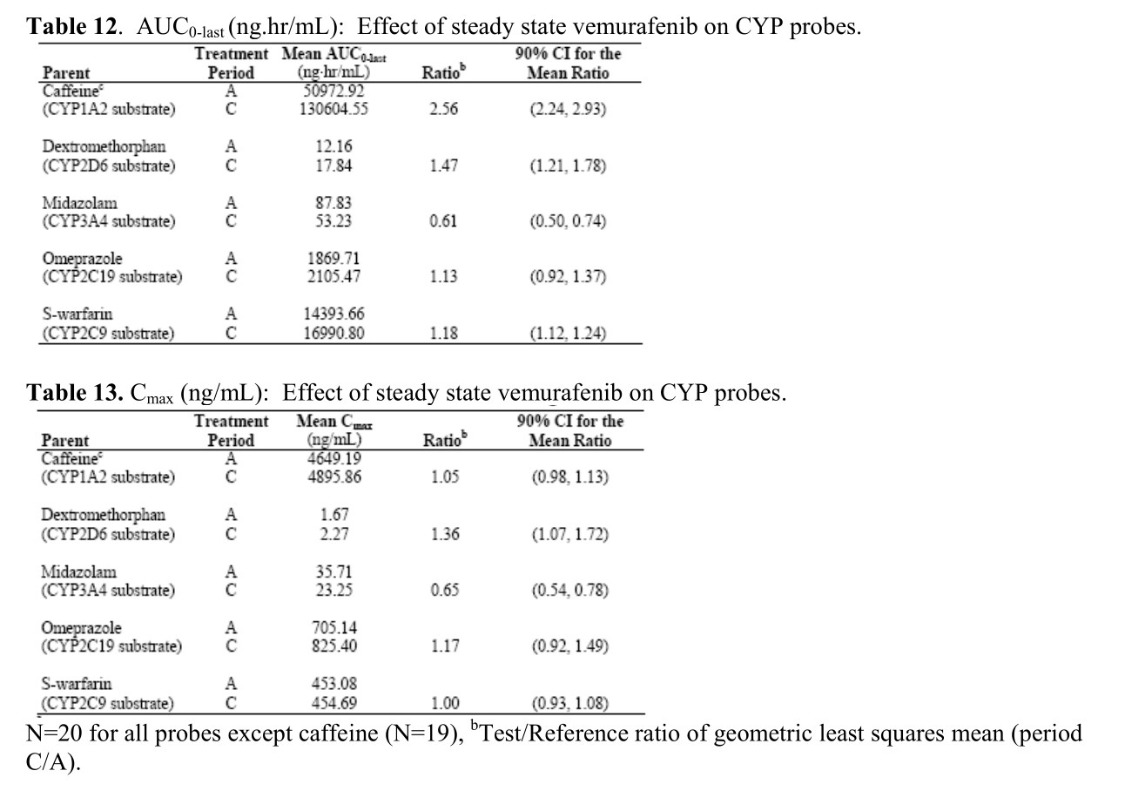
Effects on CYP enzyme
“cocktail approach” was used in trial NP22676 to investigate the potential drug-drug interactions
of vemurafenib with multiple CYP enzymes in patients with metastatic melanoma. The applicant used a combination of probe drugs known as the “Cooperstown 5+1 cocktail” in trial NP22676.
Clinical Pharmacology and Therapeutics. 2000 Oct;68(4):375-83.
In vivo
inducer of human CYP3A4
moderate inhibitor of CYP1A2
a weak inhibitor of CYP2D6

Slide 29
IND (2006-09)
The IND named PLX4032
claimed as a selective inhibitor of BRAF kinase V600E mutant and intended to be investigated in patients with tumors containing the point mutation, including melanoma
The Phase 1 protocol was evaluated and found to be safe to proceed

Slide 30
Phase I Study (2007-2009)
Original formulation: poor bioavailability
Use of new formulations of PLX4032
Form of a microprecipitated bulk powder (MBP) drug polymer-matrix
to improve the bioavailability of PLX4032
Phase 1 study: New formulation could be started at 160 mg BID
The FDA evaluation of the safety data determined.
equivalent to the original formulation at 800 mg BID in terms of serum levels of the product.
determined MTD - 960 mg BID,
verified further in an expansion cohort of patients with metastatic melanoma positive for the BRAFV600E mutation.

Slide 31
End-of Phase 1 Meeting (2009-05)
Agency proposal to develop PLX4032
based on the encouraging tumor response results from 16 patients
The Agency recommendation
Randomized Phase 3 trial with overall survival as the primary endpoint
no evidence showed that PFS is not an adequate surrogate endpoint in metastatic melanoma.
Initiate a comprehensive long term plan to monitor the safety of the product, including possible incidences of non-cutaneous squamous cell carcinomas.
development of a companion diagnostic to detect the BRAF V600E mutation during clinical trials

Slide 32
Fast Track Designation (2010-06)
The request for the Fast Track designation
Granted
On the basis that the product was being investigated to improve overall survival in patients

Slide 33
Expanded Access Program
Communication
for sponsors and the FDA to communicate and respond rapidly to important new information.
Phase I trial : publication of the unprecedented results / preliminary confirmation
Phase II trial : activity of vemurafenib confirmed
Phase III : BRIM-3
The FDA and the sponsor worked together quickly to amend the rapidly accruing BRIM-3 trial and to open an expanded access program.
Notes:
동정적사용승인계획(同情的使用承認計劃, EAP - Expanded Access Program)은 불치병에 걸렸거나 암 말기인 환자가 적절한 치료제가 없어 치료를 포기할 상황에 이를 경우 의료당국이 시판승인 전의 신약을 무상으로 공급해 치료기회를 주는 제도를 말한다. 동정적사용프로그램이라고도 한다. (compassionate use)

Slide 34
BRIM3 (Vemurafenib Front-Line Trial – Phase III Study Design)
Screening
BRAF^{V600E} mutation
Stratification:
Stage
ECOG PS (0 vs 1)
LDH (elevated vs normal)
Geographic region
Vemurafenib
960 mg PO bid
(n = 337)
Randomization
n = 675
Dacarbazine
1000 mg/m² IV q3wk
(n = 338)
Co-primary endpoints were OS and PFS

Slide 35
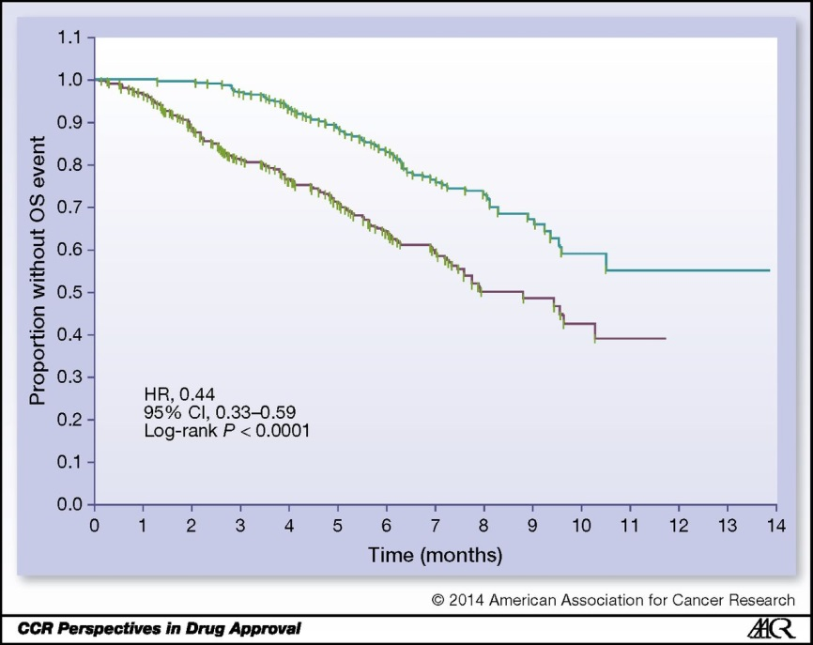
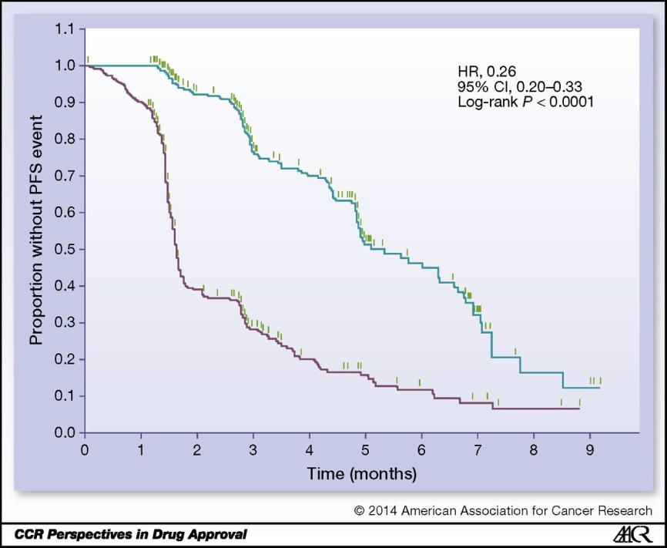
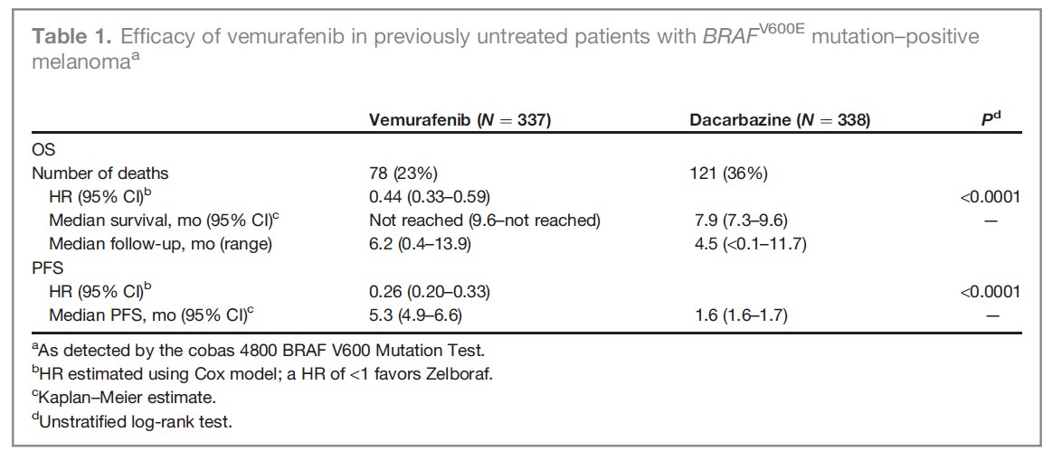
Efficacy – BRIM3
Overall Survival
Interim analysis of OS
HR: 0.37 (95% CI, 0.26–0.55; P < 0.001)
Updated OS analysis before approval
HR: 0.44 (95% CI, 0.33–0.59; P < 0.0001).
median OS
not been reached (NR) in the vemurafenib arm (95% CI, 9.6–NR)
7.9 months in the dacarbazine arm (95% CI, 7.3–9.6)

Slide 36
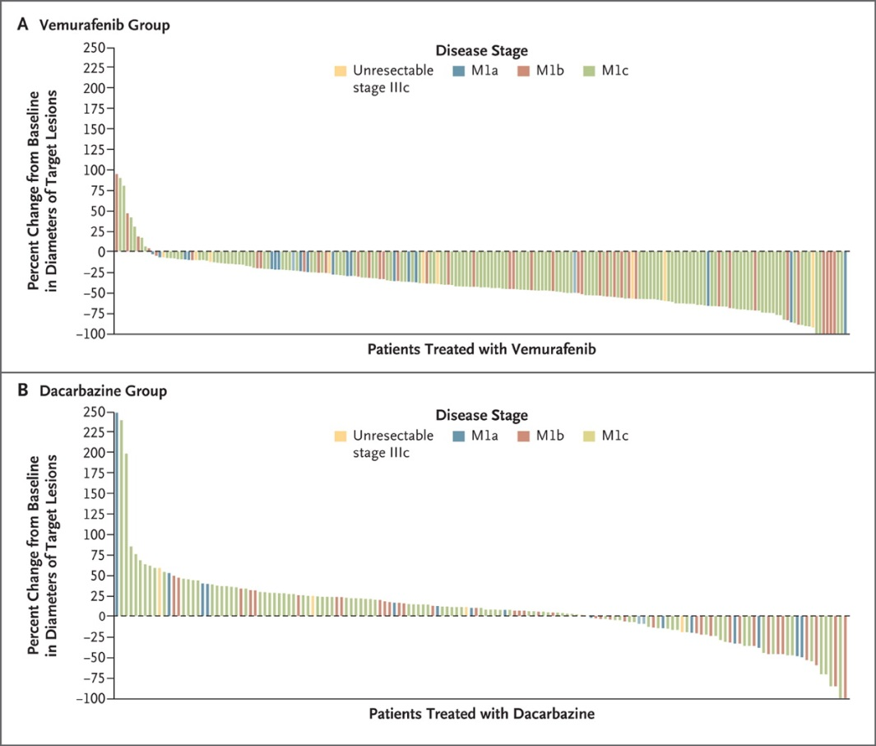
Efficacy - BRIM3
Confirmed, investigator-assessed best ORR rate
Vemurafenib: 48.4% (95% CI, 41.6%–55.2%) Dacarbazine: 5.5% (95% CI, 2.8%–9.3%)
Responses
Vemurafenib:
2 complete responses (0.9%)
104 partial responses (47.4%)
Dacarbazine:
12 partial responses (5.5%)
Chapman PB et al, NEJM, 2011

Slide 37
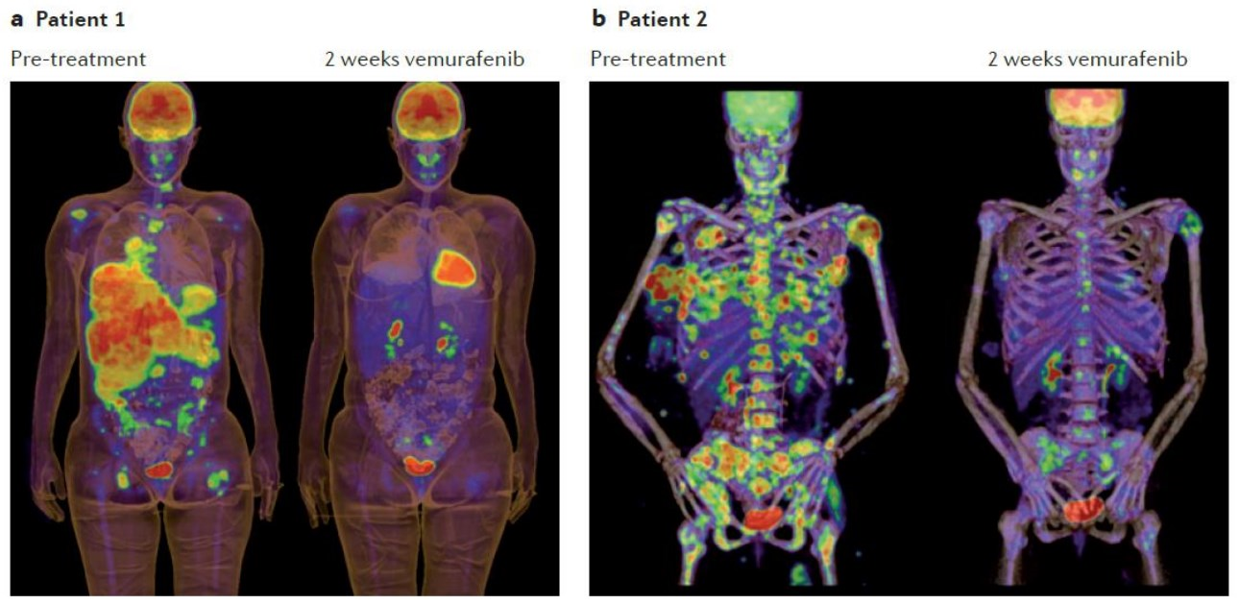
Nat Rev Drug Discov. 2012 Nov;11(11):873-86

Slide 38
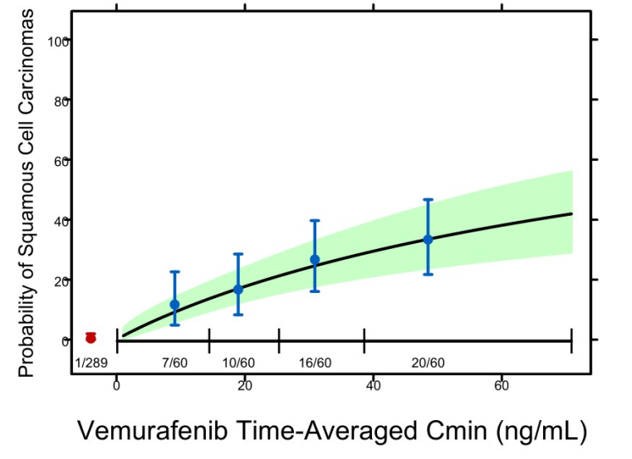
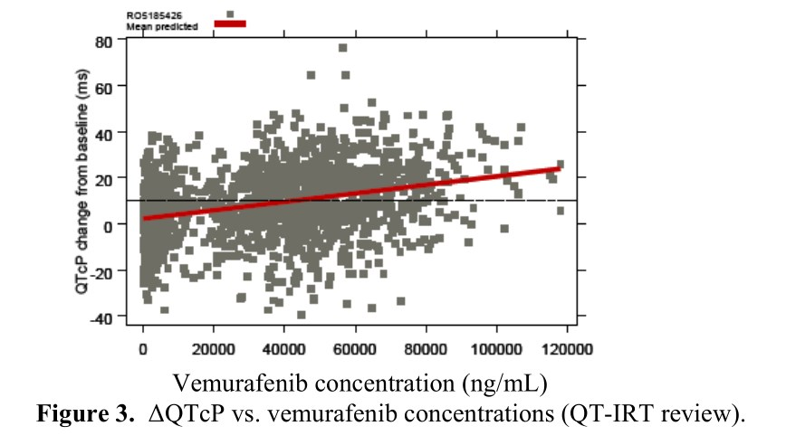
Clinical Pharmacology
Significant exposure–response relationship
progression-free survival (PFS)
vemurafenib exposure (C_{min})
Conclusive relationship between exposure and OS could not be demonstrated.
Significant exposure–response relationship
risk of cuSCC development and vemurafenib exposure (C_{min})
exposure–QTc response analysis
data from the phase II trial showed that following treatment with vemurafenib 960 mg twice daily
QTc interval was prolonged in a concentration-dependent manner
no large changes (i.e., >20 ms) in the mean QTc interval

Slide 39
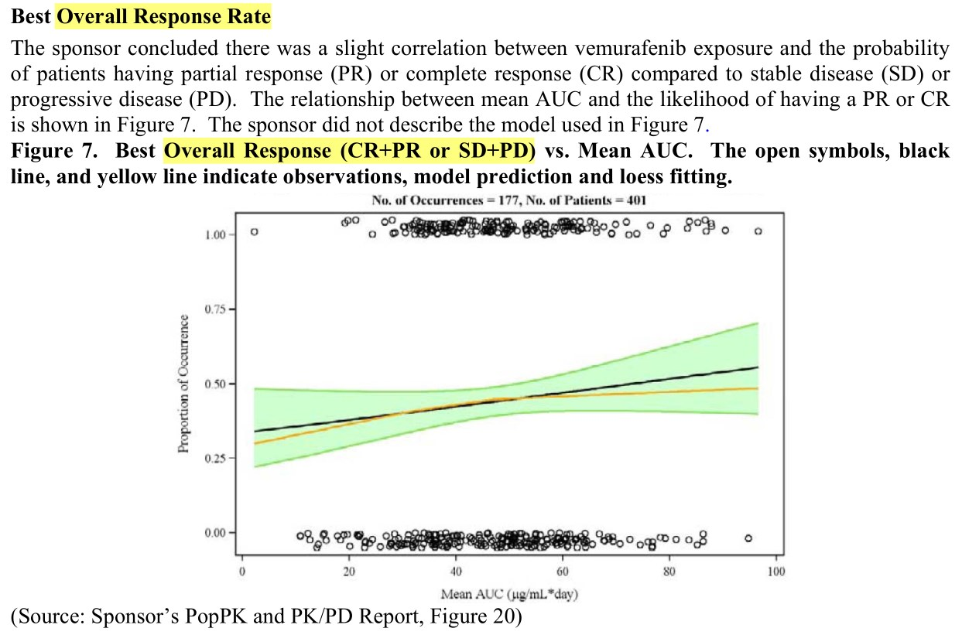

Slide 40
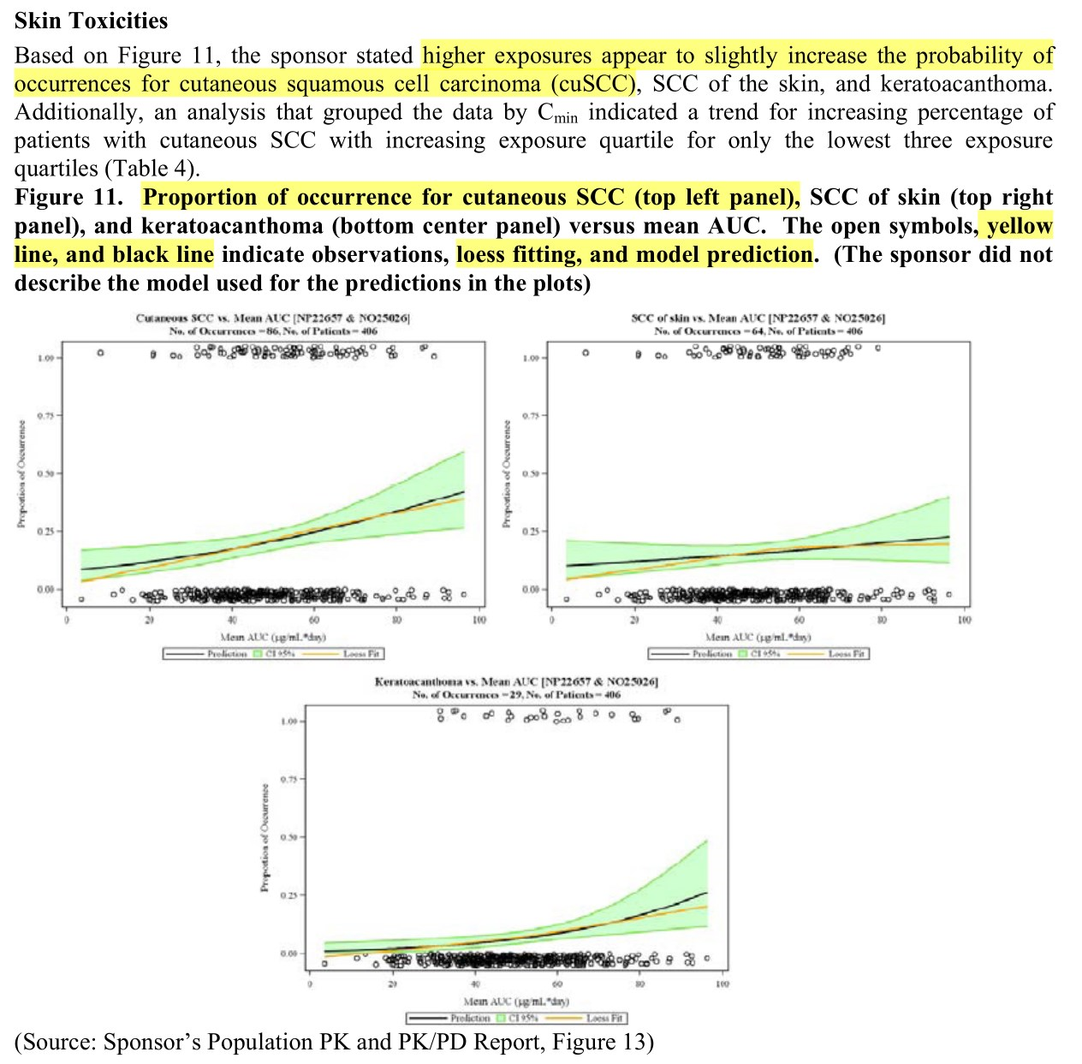

Slide 41
Safety
The most common adverse reactions (≥30%)
arthralgia, rash, alopecia, fatigue, photosensitivity reaction, and nausea.
Cutaneous squamous cell carcinomas or keratoacanthomas
approximately 24% of patients
Other adverse reactions
hypersensitivity, Stevens-Johnson syndrome, toxic epidermal necrolysis, uveitis, QT prolongation, and liver enzyme laboratory abnormalities.

Slide 42
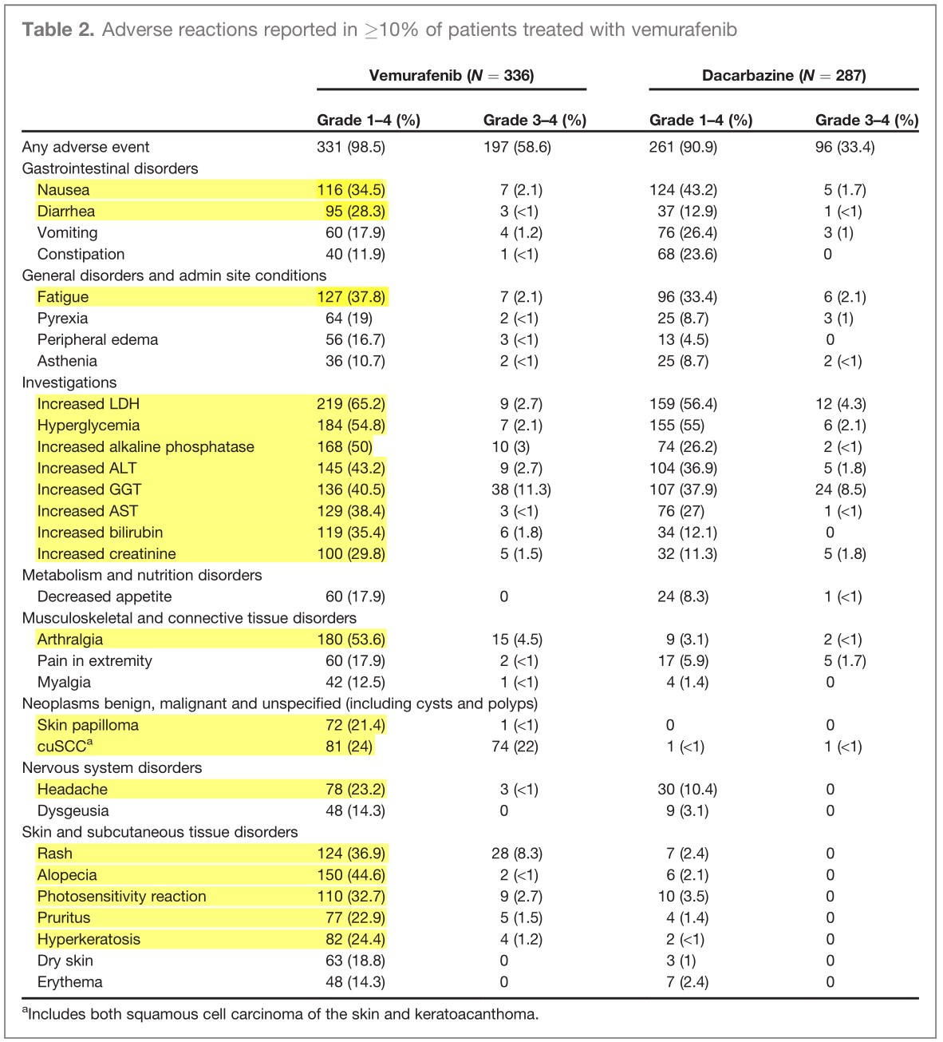

Slide 43
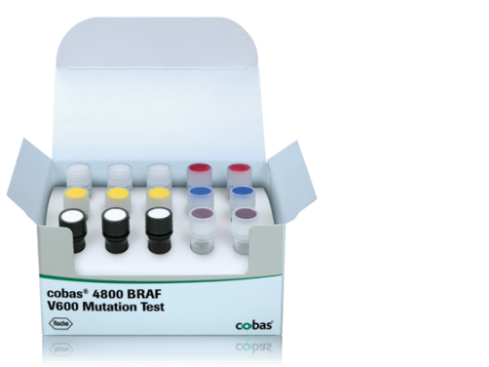
Companion Diagnostic for Vemurafenib
In vitro diagnostic: The cobas 4800 BRAF V600 Mutation Test
real-time PCR-based in vitro diagnostic
DNA from formalin-fixed, paraffin-embedded human melanoma tissue
Goal: selection of patients with BRAF^{V600E}-mutated melanoma for treatment with vemurafenib.
Notes:
https://molecular.roche.com/assays/cobas-4800-braf-v600-mutation-test/
A companion diagnostic for vemurafenib
The cobas® 4800 BRAF V600 Mutation Test detects the BRAF V600E mutation in formalin-fixed, paraffin-embedded (FFPET) human melanoma tissue. It is designed to help select patients for treatment with vemurafenib, an oral medicine designed to treat patients whose melanoma tumors harbor a mutated form of the BRAF gene.
Features and Benefits
The cobas® BRAF Mutation Test was used in pivotal clinical trials for vemurafenib, to select patients whose tumors harbor the V600E mutation in the BRAF gene.
In pre-clinical and clinical investigations, the cobas® BRAF Mutation Test had 97.3% positive agreement in detecting the BRAF V600E (1799 T>A) mutation, which represents >~85% of all BRAF mutations reported in the COSMIC database.
The cobas® BRAF Mutation Test is more sensitive in the detection of V600E mutations than Sanger sequencing.*
In formalin-fixed, paraffin-embedded tissue (FFPET), the cobas® BRAF Mutation Test can detect V600E mutations at >5% mutation level.*
The test may also detect other V600 mutations such as V600D and V600K.*
The cobas® BRAF Mutation Test has a low failure rate and is highly reproducible across operators, reagent lots and testing days.*
The cobas® BRAF Mutation Test can be performed in <8 hours from receipt of specimen.
Liquid, ready-to-use reagents are provided in the test kit to increase laboratory efficiency.
The test kits have >12 months shelf life from date of manufacture and upon opening each reagent maintains open-vial stability for up to 90 days.

Slide 44
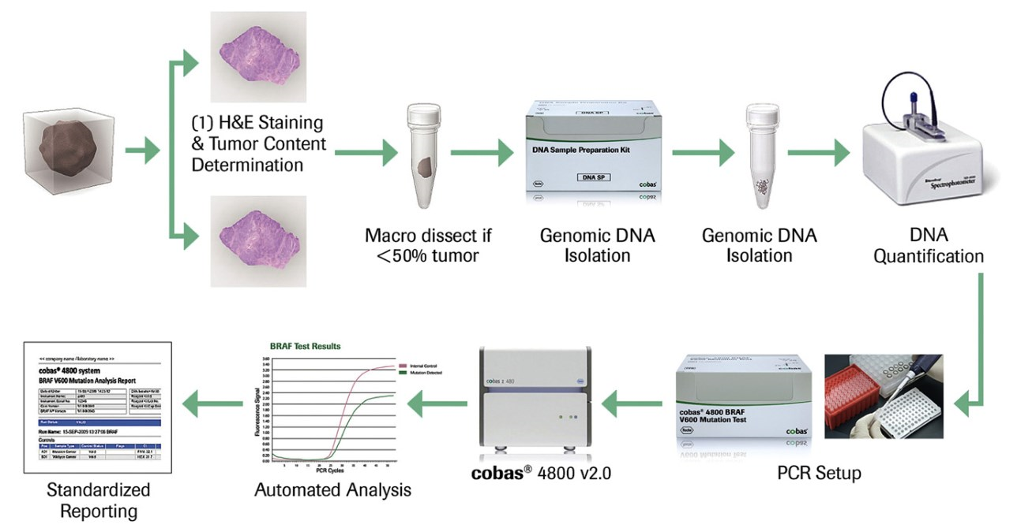
Companion Diagnostic for Vemurafenib
(Cheng, 2012, New Biotech)

Slide 45
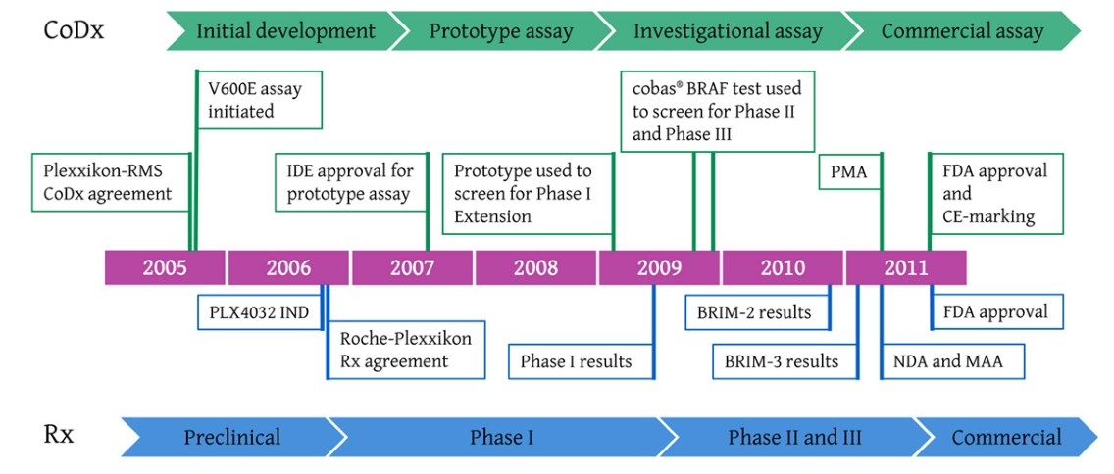
Companion Diagnostic for Vemurafenib
(Cheng, 2012, New Biotech)

Slide 46
Discussion
No approved agents until 2011
Vemurafenib: survival benefit in advanced malignant melanoma
Time from IND to approval: ~ 5 years
Collaboration of Plexikkon and Roche (Roche MS)
IND and Phase I : Plexikkon
1st personalized therapy for melanoma
Patients are selected using an analytically and clinically validated test.

Slide 47
감사합니다.
References
FDA, CDER, 202429Orig1s000
Medical Reviews https://www.accessdata.fda.gov/drugsatfda_docs/nda/2011/202429Orig1s000MedR.pdf
Approval Package 202429Orig1s000 https://www.accessdata.fda.gov/drugsatfda_docs/nda/2011/202429Orig1s000Approv.pdf
Clinical Pharmacology https://www.accessdata.fda.gov/drugsatfda_docs/nda/2011/202429Orig1s000ClinPharmR.pdf
Pharmacology https://www.accessdata.fda.gov/drugsatfda_docs/nda/2011/202429Orig1s000PharmR.pdf

Slide 48
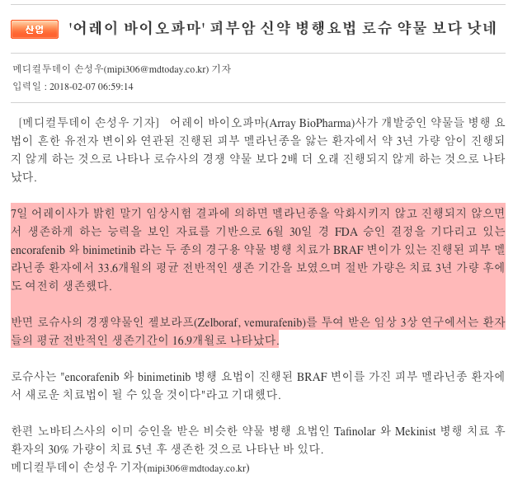
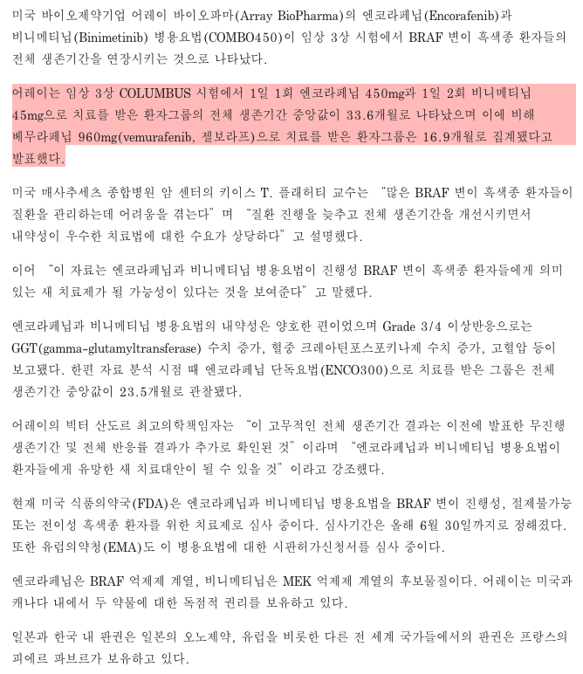

Slide 49
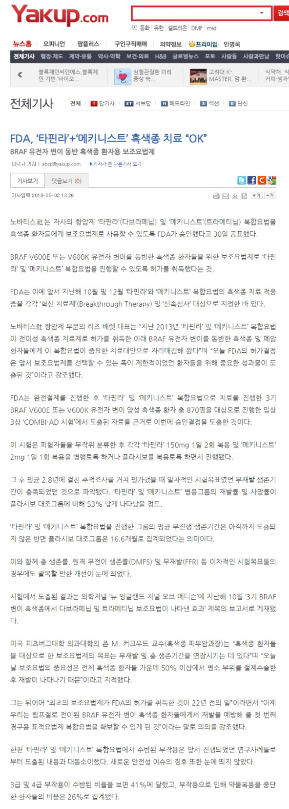

Slide 50
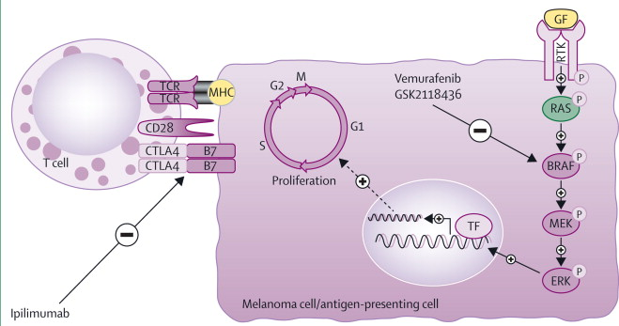
Mechanism of Action
Bombeli, Lancet, 2014
Notes:
http://www.thelancet.com/journals/lanonc/article/PIIS1470-2045(13)70333-4/fulltext
Figure 1
Present strategies to manage advanced stage melanomas include inhibition of the mutant form of BRAF kinase (a common mutation being BRAFV600E ; vemurafenib and GSK2118436) and T-cell activation (ipilimumab)
TCR=T-cell receptor. GF=growth factor. MHC=major histocompatibility complex. RTK=receptor tyrosine kinase. CTLA4=cytotoxic T lymphocyte antigen 4. TF=transcription factor.
View Large Image | View Hi-Res Image | Download PowerPoint Slide

Slide 51
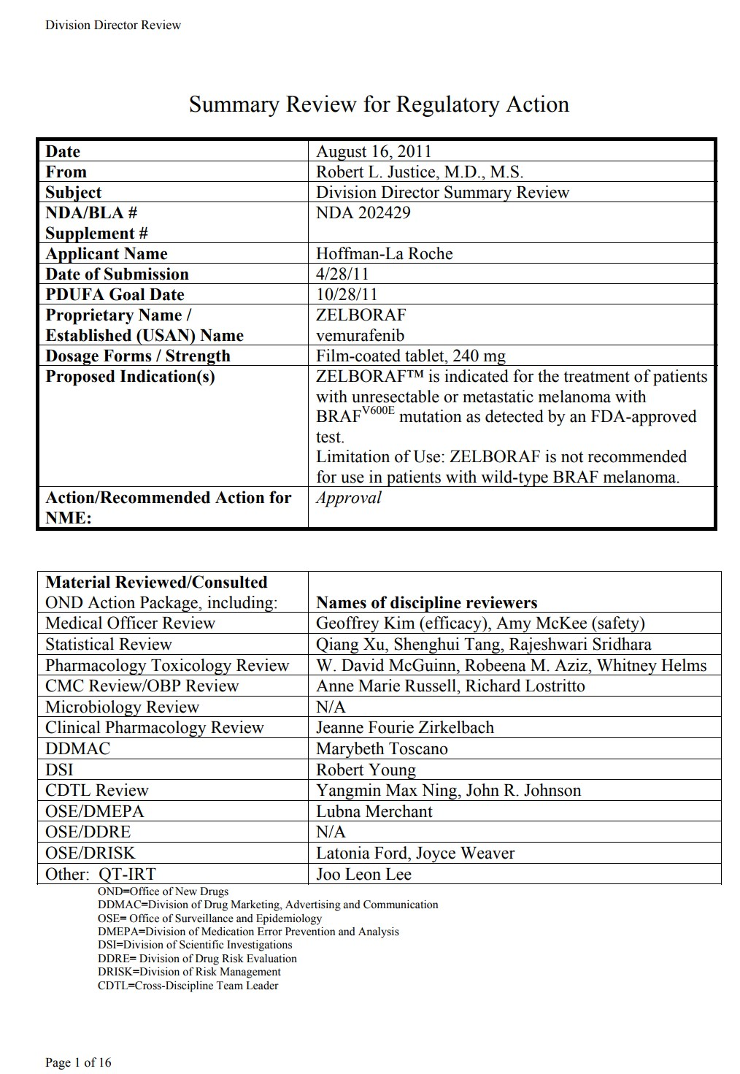
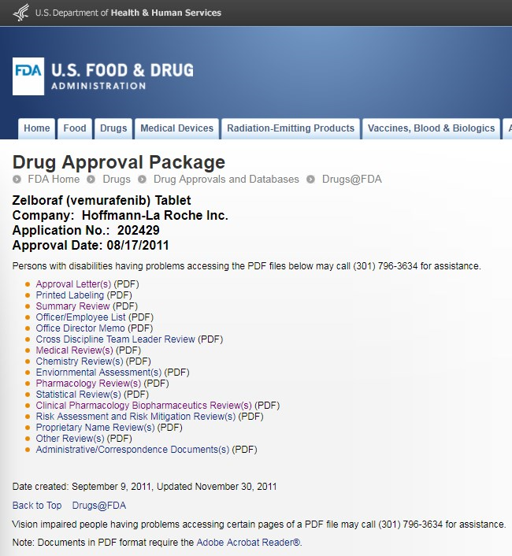
1st page of summary review (16 pages)

Slide 52
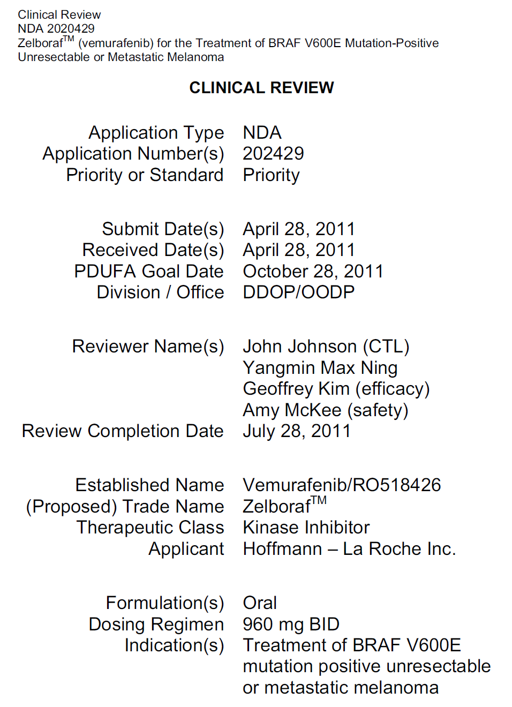
1st page of medical review (97 pages)
Priority review: 6 months (Standard review: 10 months)
Division of Drug Oncology Products/
Office of Oncology Drug Products
Clinical Review, NDA 2020429

Slide 53
Review: Pharmacology (115 pages)

Slide 54
Nonclinical Findings
Observational Battery. Tests with isolated canine cardiac Purkinje fibers were
inconclusive but showed a decrease in V max of about 50% suggesting the possibility of
inhibition of conduction. This correlated with an increase in AV block and QT
prolongation seen in dogs. QT prolongation occurs clinically.
Rats clear vemurafenib much more rapidly than humans. Studies using the
maximum feasible dose cause little toxicity despite achieving exposures comparable to
or higher than those that cause toxicity clinically.
Dogs show signs of toxicity at exposures significantly less than those seen
clinically. Doses of 450 mg/kg/day BID (18000 mg/m 2 /day) caused unacceptable toxicity
and mortality by Day 8. Prior to Day 8 the dogs showed clinical signs of excessive
salivation, vomiting, dehydration, soft or malformed feces and hypoactivity. Hypoactivity
correlates with the fatigue seen clinically. Vomiting also occurs clinically. These two
toxicities were dose limiting in Phase I clinical studies. In a 13-week study, a lower dose
of 300 mg/kg/day caused three deaths by Day 31. No dogs died after that time, an
observation that correlated with a steady decrease in exposure. This decrease was
probably because of induction of metabolism. Dogs that survived had increases in ALT,
GGT, amylase and ALP suggesting damage to the liver and pancreas. Hepatic toxicity
occurs clinically. Cholesterol and triglycerides were increased. Cholesterol biosynthesis

